Slide 1
Manufacturing and Service Operations MSO 40.012
R Desmicht – Adjunct Professor SUTD

Slide 2
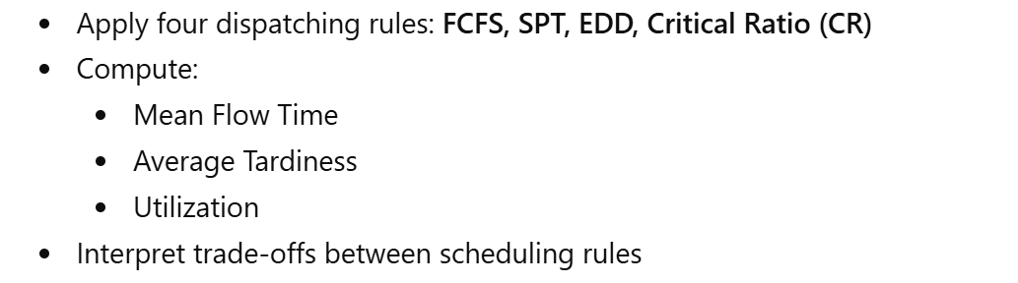
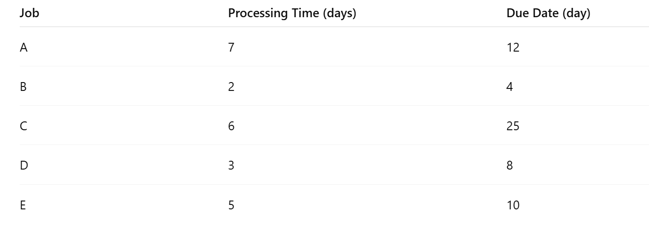
Simple sequencing rules

Slide 3
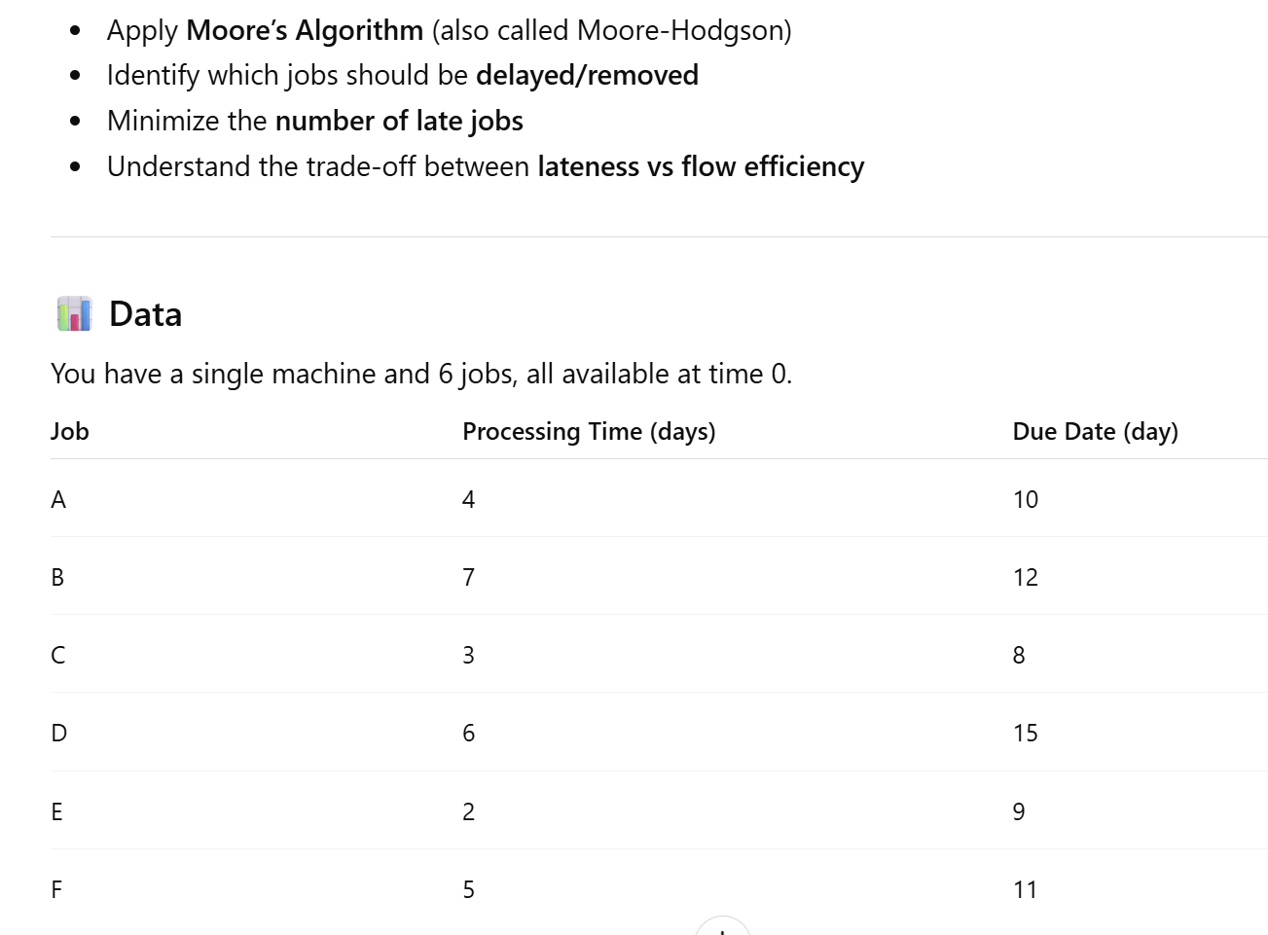
Moore algorithm
Compare with EDD

Slide 4
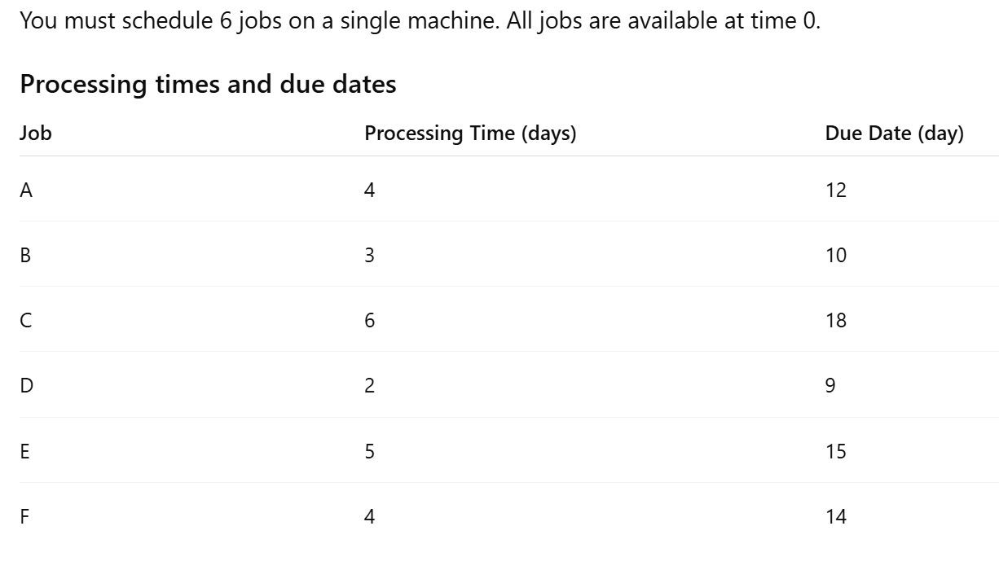
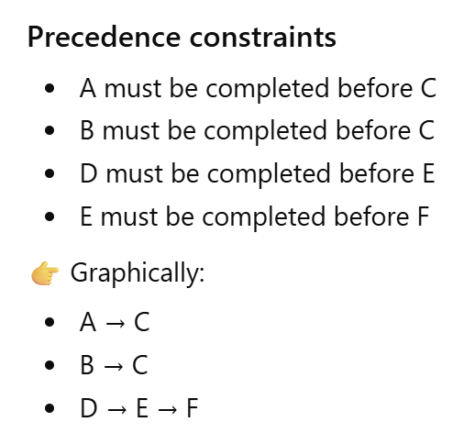
Lawler Algorithm

Slide 5
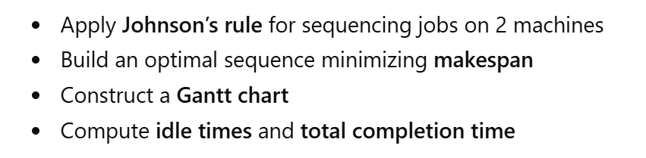
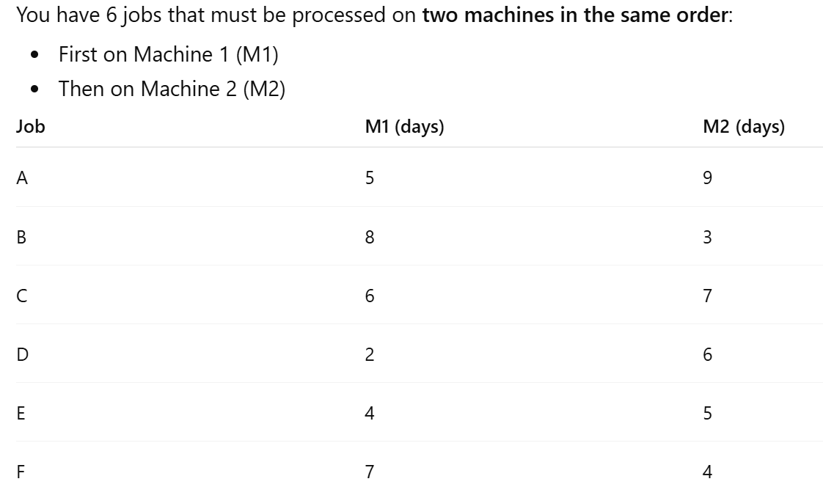
Johnson algorithm for n jobs on 2 machines

Slide 6
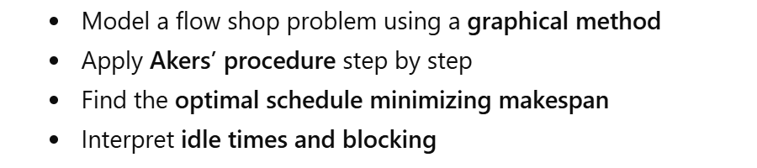
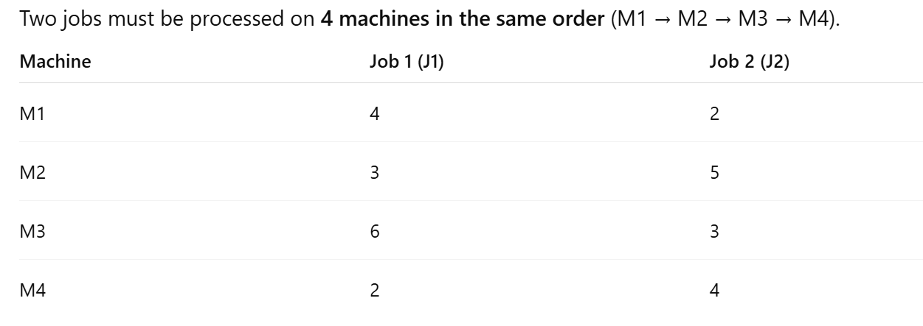
Akers procedure

Slide 7
Akers procedure

Slide 8
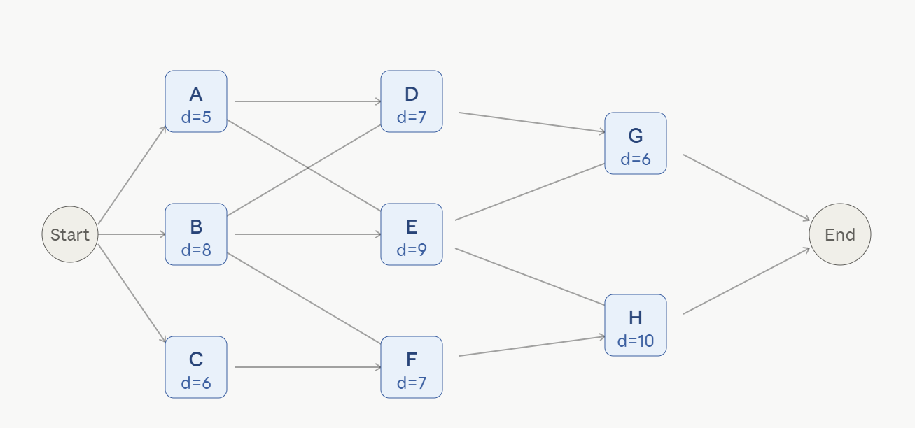
Project Management
Find the project completion time and critical path using the forward backward method.

Slide 9
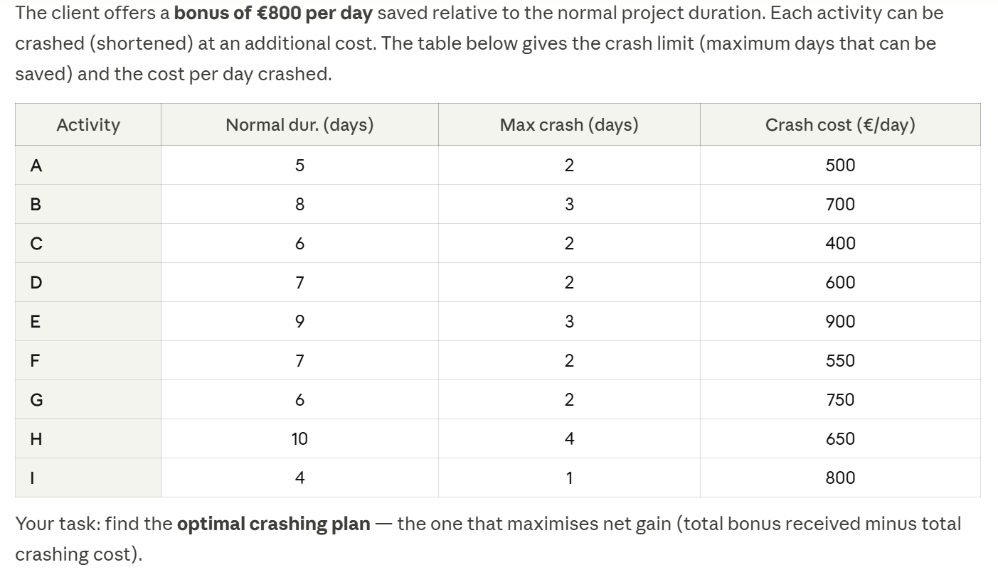
Project Management

Slide 10
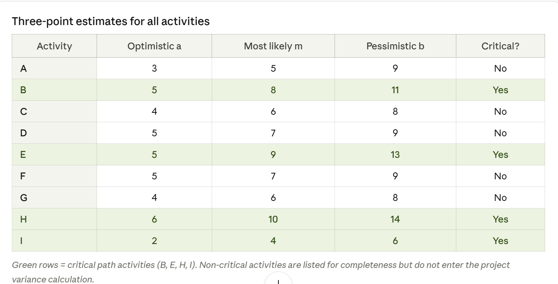
Project Management
Unfotunately we know that all activities have variability.
What is the probability for the project to really be completed in 31 days?
If we want to be sure at 98% to complete the project on time what duration should we commit to?

